Slide 1
PROJECT-1 PREDICTING STUDENT PERFORMANCE
Team Members
Team Member 1: 2210990725
Team Member 2: 2210990724
Team Member 3: 2210990143
Team Member 4: 2210990712

Slide 2
CONTENT
Problem Statement
Objective
Tools Used
Data Summary
Features description
Exploratory Data Analysis
Conclusion

Slide 3
PROBLEM STATEMENT
Develop a model to predict student performance (e.g., grades) based on features such as study time, attendance, socioeconomic status, etc. This project involves data preprocessing, feature selection, and training a regression model using algorithms like linear regression, decision trees, or ensemble methods.

Slide 4
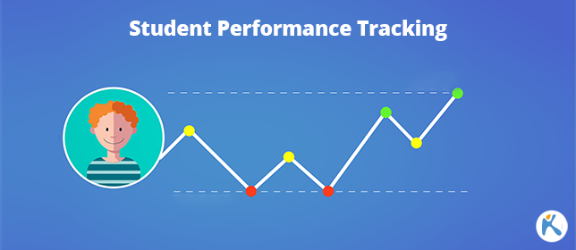

Slide 5
OBJECTIVE
The objective of the project is to perform an exploratory data analysis, data pre-processing, data cleaning and at the end, apply different Data Visualization techniques to get the meaningful insight from the given data. This project aims applying some amazing Python Libraries like as Plotty which will give a boost to our visual understanding of the data.

Slide 6
TOOLS USED
Google Collab is used as IDE.
Pandas and NumPy are used for Data Manipulation & Pre-processing and Mathematical functions respectively.
Exploratory data analysis is automated by data prep.
For visualization of the plots, Matplotlib, Seaborn are used.
GitHub is used as version control system

Slide 7

DATA SUMMARY
Numerical Data
Maths score
Reading score
Writing score
Categorical Data
race/ethnicity
Gender
Unique Data
n/a

Slide 8
DATA SET
This is the Airbnb Hosting dataset. In the below table it shows the top and bottom 5 rows respectively
gender | race/ethnicity | parental level of education | lunch | test preparation course | math score | reading score | writing score
female | group D | some college | standard | completed | 59 | 70 | 78
male | group D | associate's degree | standard | none | 96 | 93 | 87
female | group D | some college | free/reduced | none | 57 | 76 | 77
male | group B | some college | free/reduced | none | 70 | 70 | 63
female | group D | associate's degree | standard | none | 83 | 85 | 86
male | group C | some high school | standard | none | 68 | 57 | 54
female | group E | associate's degree | standard | none | 82 | 83 | 80
female | group B | some high school | standard | none | 46 | 61 | 58
male | group C | some high school | standard | none | 80 | 75 | 73
female | group C | bachelor's degree | standard | completed | 57 | 69 | 77
male | group B | some high school | standard | none | 74 | 69 | 69
male | group B | master's degree | standard | none | 53 | 50 | 49
male | group B | bachelor's degree | free/reduced | none | 76 | 74 | 76
male | group A | some college | standard | none | 70 | 73 | 70
male | group C | master's degree | free/reduced | none | 55 | 54 | 52
male | group E | master's degree | free/reduced | none | 56 | 46 | 43
female | group C | some college | free/reduced | none | 35 | 47 | 41
female | group C | high school | standard | none | 87 | 92 | 81
female | group E | associate's degree | free/reduced | none | 80 | 82 | 85

Slide 9
FEATURES DESCRIPTION
Gender: Indicates the gender of the student, whether they are male or female.
Race/Ethnicity: Describes the racial or ethnic group to which the student belongs. In this dataset, the groups are labeled A, B, C, D, and E.
Parental Level of Education: Represents the highest level of education attained by the student's parents. Categories include some high school, high school, some college, associate's degree, bachelor's degree, and master's degree.
Lunch: Specifies whether the student receives a standard lunch or qualifies for free/reduced lunch. This can be an indicator of the student's socioeconomic background.
Test Preparation Course: Indicates whether the student completed a test preparation course before taking the exam. Options are "completed" or "none."
Math Score: Represents the score achieved by the student in the math section of the exam.
Reading Score: Represents the score achieved by the student in the reading section of the exam.
Writing Score: Represents the score achieved by the student in the writing section of the exam.

Slide 10
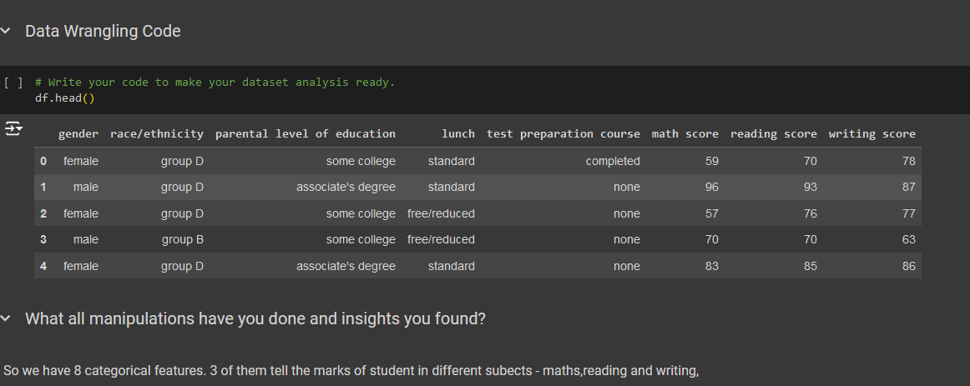
DATA WRANIGLING
We have not applied an kind of data wrangling as it is not required.

Slide 11
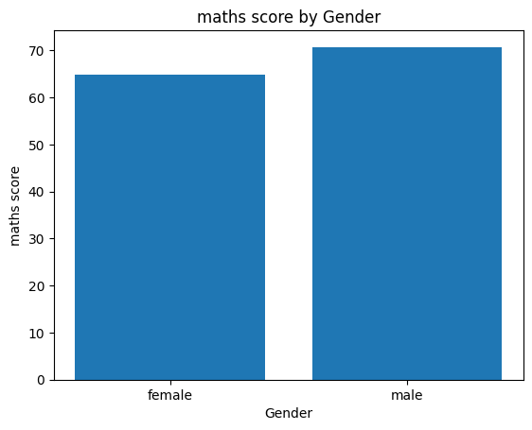
Bar Chart
A comparison of math scores between females and males. The scores are listed alongside the corresponding gender.
The scores range from 0 to 70, with multiple instances of 60, 50, and 30. This could indicate that the scores are grouped into categories or bins.

Slide 12
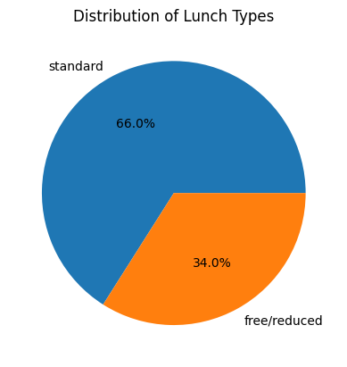
PIE CHART
The specific chart chosen in this case is a pie chart. Pie charts are commonly used to visualize the distribution of categorical data, particularly when you want to represent proportions or percentages of different categories relative to the whole.
he majority of the luch type is standard, making up approximately 66%. The remaining portion of the lunch is free,, making up approximately 34%.

Slide 13
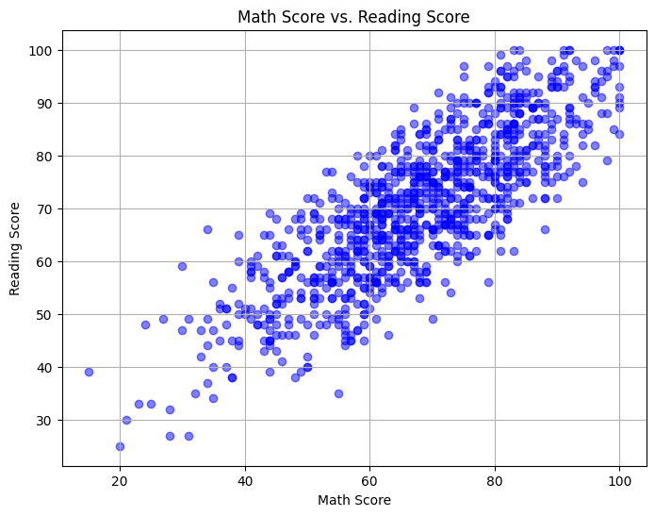
SCATTER PLOT
There is a moderate positive correlation between math scores and reading scores, meaning that students who perform well in math also tend to perform well in reading.
Most data points are clustered in the middle of the graph, with a few outliers having high math scores and low reading scores or vice versa.
The trend line indicates that for every 1-point increase in the math score, there is a corresponding increase of approximately 0.6 points in the reading score.

Slide 14
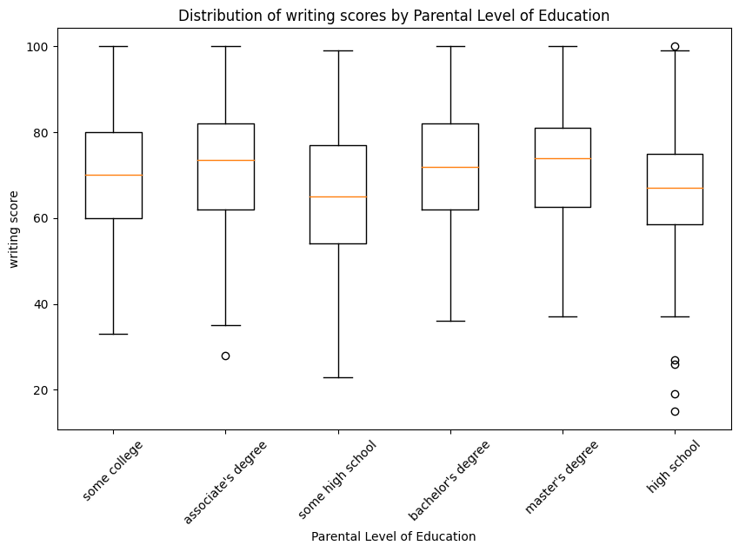
BOX PLOT
This is a bar chart comparing the writing scores of students with different levels of parental education. The purpose of the chart is to show the relationship between the students' writing scores and their parents' education levels.
The chart displays four categories of parental education levels: "Some College," "High School," "Some High School," and "Less than High School." The writing scores range from 0 to 50. The chart shows that students with parents who have higher levels of education generally have higher writing scores.

Slide 15
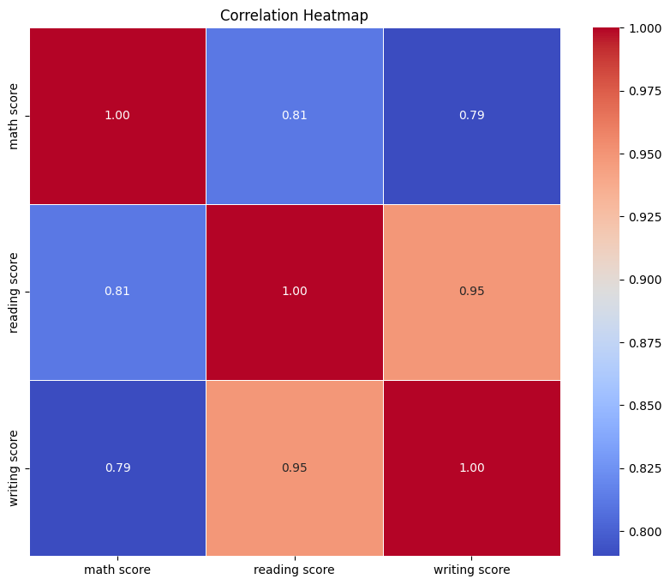
CORRELATION HEATMAP
Math score and reading score have a strong positive correlation (0.81), indicating that higher math scores are generally associated with higher reading scores.
Math score and writing score have a very strong positive correlation (0.95), meaning that higher math scores are strongly associated with higher writing scores.
Reading score and writing score have an extremely strong positive correlation (1.00), showing that higher reading scores are almost always associated with higher writing scores.

Slide 16
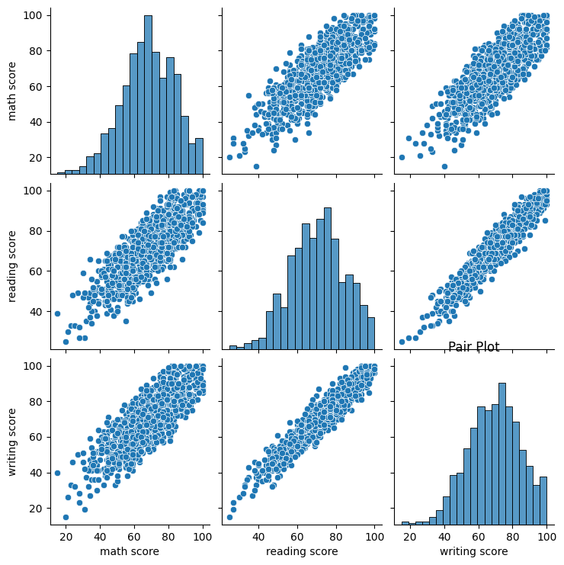
PAIR PLOT
Math score and reading score have a moderate positive correlation, as shown by the generally increasing trend in the scatter plots and the positive correlation coefficients (0.81, 0.84, and 0.84) in the lower triangle.
Math score and writing score have a strong positive correlation, as shown by the generally increasing trend in the scatter plots and the positive correlation coefficients (0.95, 0.96, and 0.95) in the lower triangle.
Reading score and writing score have an extremely strong positive correlation, as shown by the increasing trend in the scatter plots and the correlation coefficients close to 1.00 (0.98, 1.00, and 0.99) in the lower triangle.

Slide 17
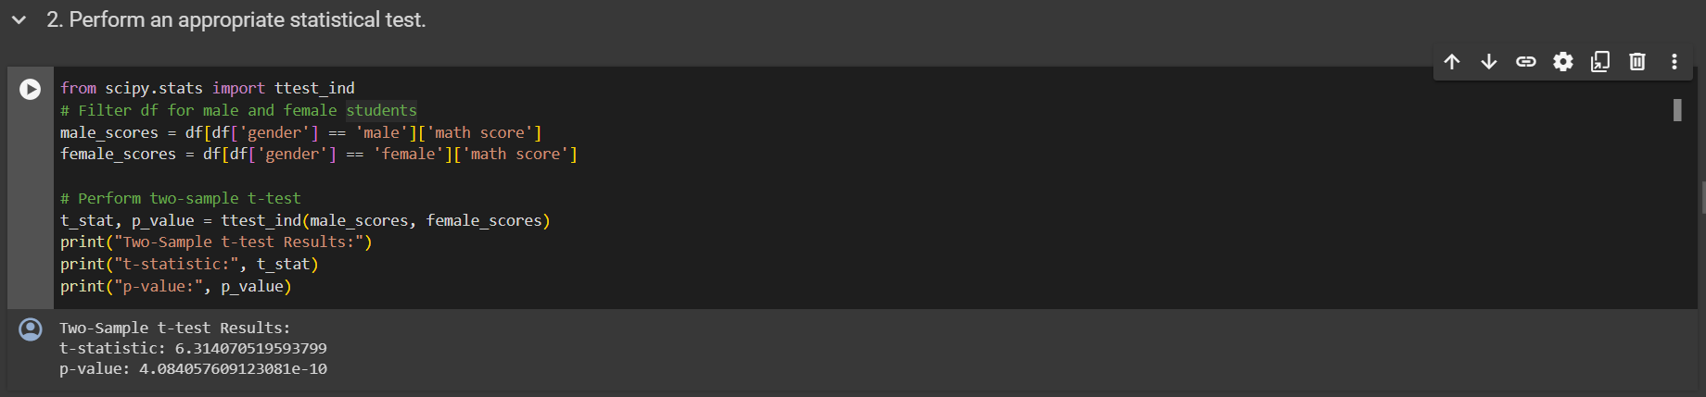
HYPOTHESIS TESTING
Research Hypothesis (Alternate Hypothesis): There is a significant difference in the average math scores between male and female students.
Null Hypothesis: There is no significant difference in the average math scores between male and female students.

Slide 18
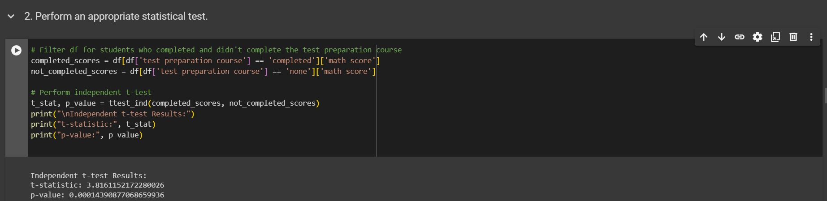
HYPOTHETICAL STATEMENT 2
Research Hypothesis (Alternate Hypothesis): Students who completed the test preparation course have higher average exam scores than those who did not.
Null Hypothesis: There is no difference in average exam scores between students who completed the test preparation course and those who did not.

Slide 19
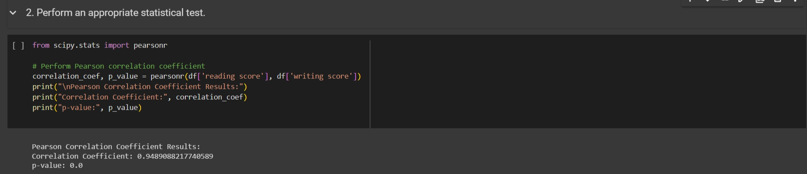
HYPOTHETICAL STATEMENT 3
Research Hypothesis (Alternate Hypothesis): There is a significant correlation between reading and writing scores among students.
Null Hypothesis: There is no significant correlation between reading and writing scores among students.

Slide 20
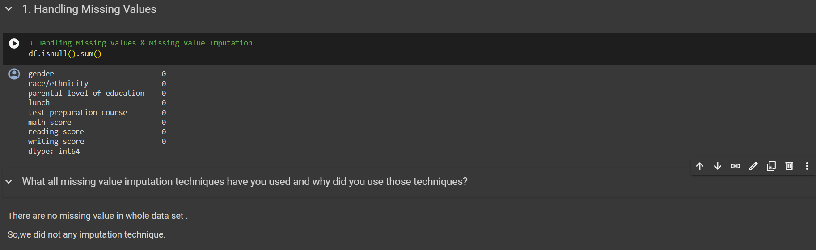
FEATURE ENGINEERING AND DATA PRE-PROCESSING

Slide 21
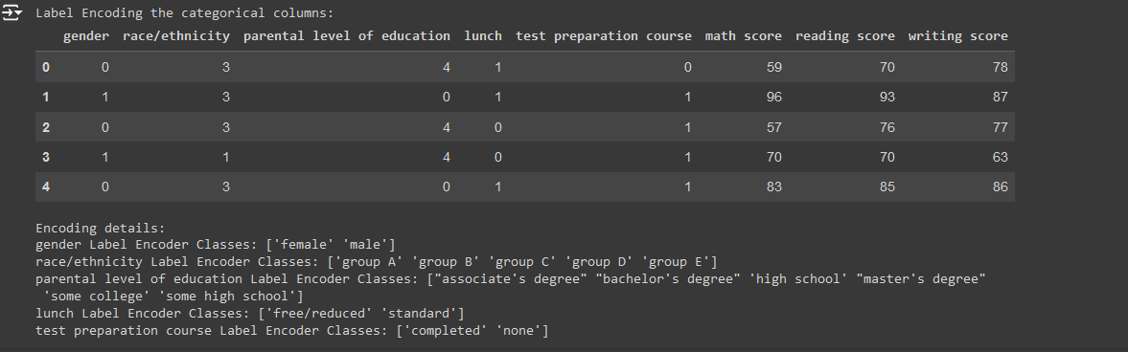
CATEGORIAL ENCODING
WE HAVE USED THE LABEL ENCODER TECHNIQUE FOR ENCODING THE CATEGORICAL COLUMNS IN THE DATASET.

Slide 22
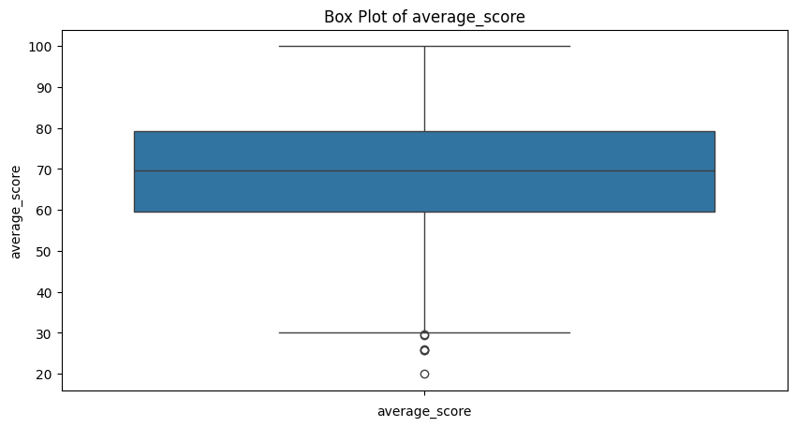
HANDLING OUTLIERS
The outlier treatment techniques used in the provided code include removing outliers, transformations, capping or winsorizing, and robust statistical methods.

Slide 23
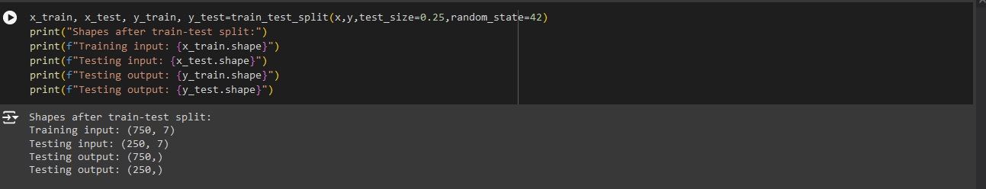
DATA SPLITTING

Slide 24
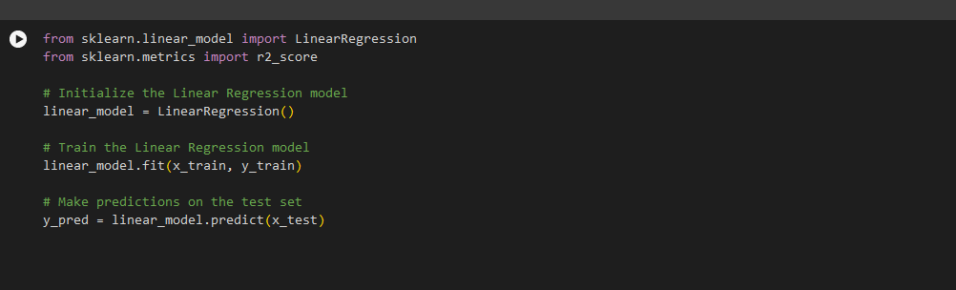
ML MODEL 1
LINEAR REGRESSION
Mean Squared Error: 27.20734994601512
R-squared score: 0.8740713514754447

Slide 25
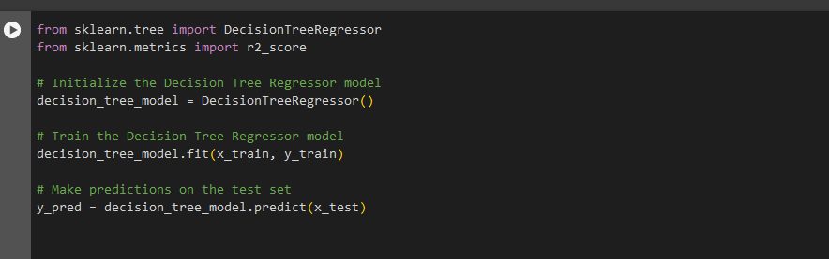
ML MODEL-2
DecisionTreeRegressor
Mean Squared Error: 55.716
R-squared score: 0.7421196626971843

Slide 26
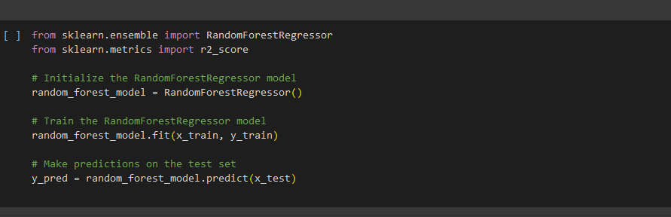
ML MODEL-3
RandomForestRegressor
Mean Squared Error: 31.349544800000004
R-squared score: 0.8548992894803336

Slide 27
CONCLUSION
We have successfully performed all the algorithms and other necessary techniques

